Slide 1
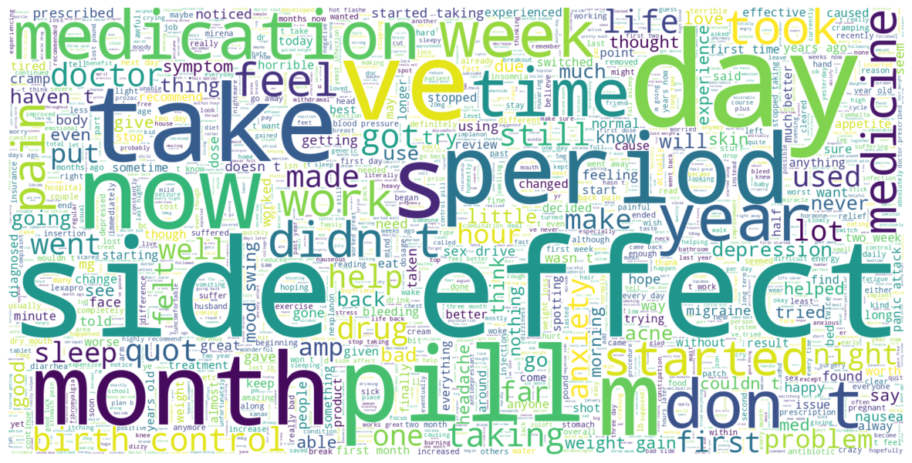
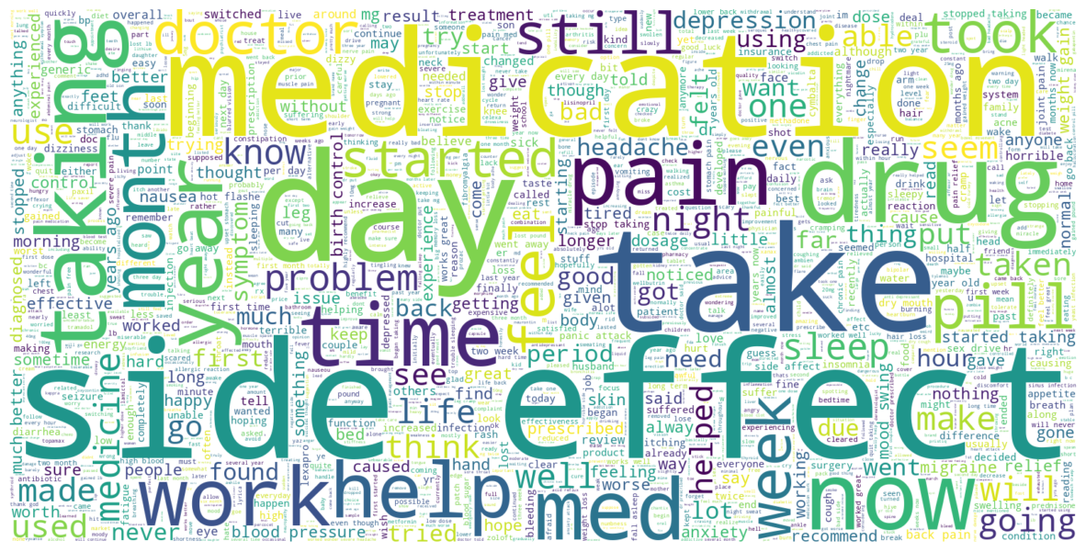
Sentiment Analysis for Drug Effectiveness, Satisfaction and Side Effects
Jimmy Zhang, Shawn Oyer, and Thu Tran
DSCI 691, Spring 2024
Notes:
jimmy

Slide 2
Team Members
Jimmy Zhang
Interests: Advanced Manufacturing, IoT, Robotics, Embedded Systems, HPC, Data Science
Background: BS in Chemical Engineering and is currently a Manufacturing Automation Engineer at Merck & Co.
Shawn Oyer
Interests: Geographic Information Systems (GIS), Data Science, Remote Sensing, Quality Control.
Background: BS in Geography and Spanish and MS in Applied Geography and Data Science. Currently work as a geospatial data steward/manager with the National Geospatial-Intelligence Agency (NGA).
Thu Tran
Interests: Chemical engineering, chemical manufacture technology, process automation, data visualization
Background: BS in Chemical Engineering and MS in Data Science. Working as a manufacturing technology engineer in Dupont.
Notes:
all

Slide 3
Intro
Applying deep learning to the methods and findings of a 2018 research article entitled “Aspect-Based Sentiment Analysis of Drug Reviews Applying Cross-Domain and Cross-Data Learning”
Importance of online review sites and opinion forums in understanding user experiences with pharmaceutical products.
One of the primary objectives of the paper is to analyze sentiments in drug reviews concerning overall satisfaction, side effects, and effectiveness.
Motivation: post-market surveillance
Notes:
jimmy

Slide 4
NLP Task: Sentiment Analysis
Sentiment analysis involves transforming textual data into numerical ratings to understand user sentiments.
The paper uses traditional machine learning models
Our project aims to create neural network models to predict sentiments related to overall satisfaction, side effects, and effectiveness.
Notes:
jimmy

Slide 5
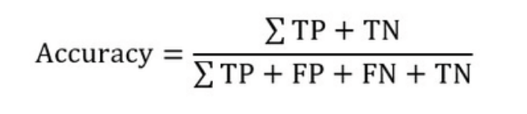
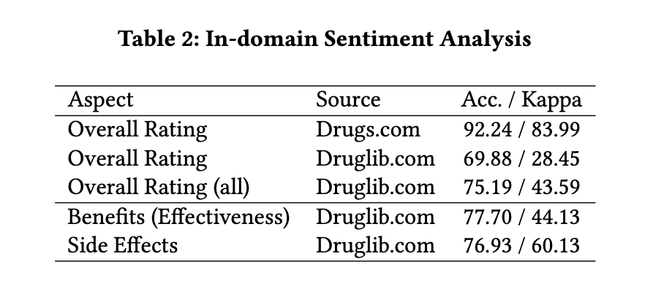
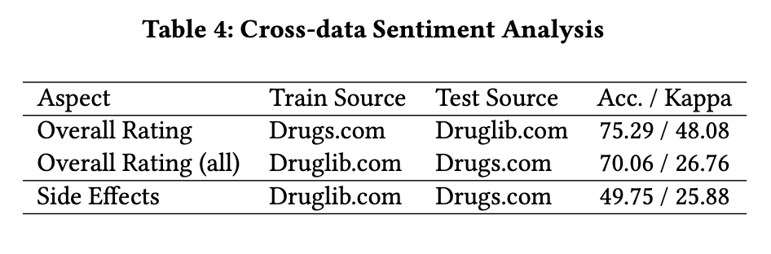
Baseline Results
Cohen's Kappa (κ) is a statistical measure used to quantify the level of agreement between two raters (or judges, observers, etc.) who each classify items into categories. It's especially useful in situations where decisions are subjective and the categories are nominal (i.e., they do not have a natural order).
Notes:
jimmy

Slide 6
Pre-Processing
Drug.com
Eliminated missing data values
Reclassification of rating column from 0 - 10 scale to 0-2 scale
Train set : 161,297 rows and 6 columns
Test set: 53,766 rows and 6 columns
Webmd.com
Eliminated missing data values
Dropped the ‘other’ condition
Calculated the overall rating by combining Satisfaction, EaseofUse
Reclassification of overall rating column from 0 - 10 scale to 0-2 scale
362,806 rows and 12 columns
Notes:
thu

Slide 7
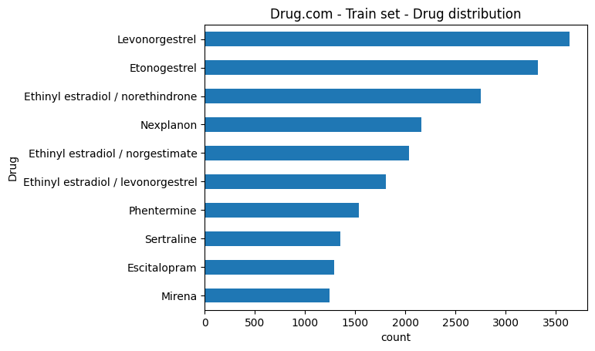
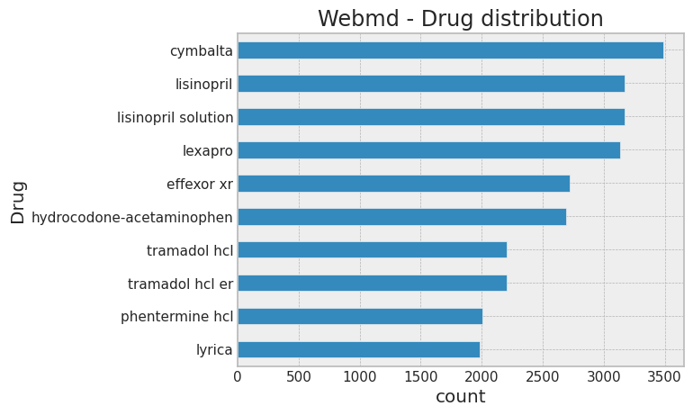
Drug Distribution
Notes:
thu

Slide 8
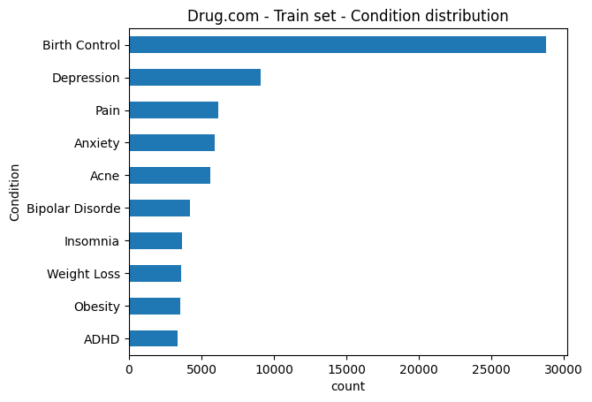
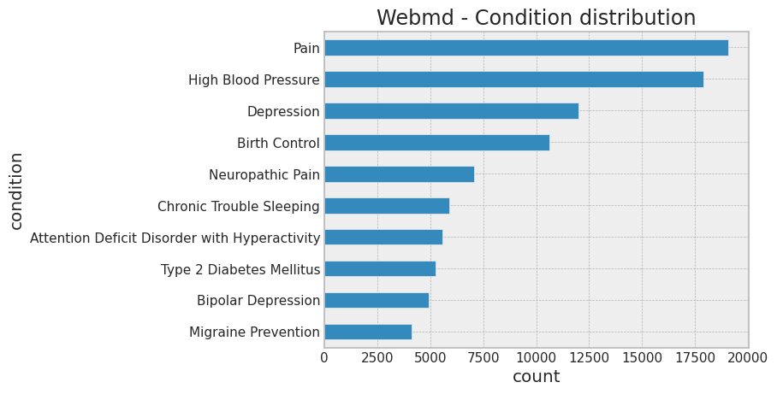
Condition Distribution
Notes:
t

Slide 9
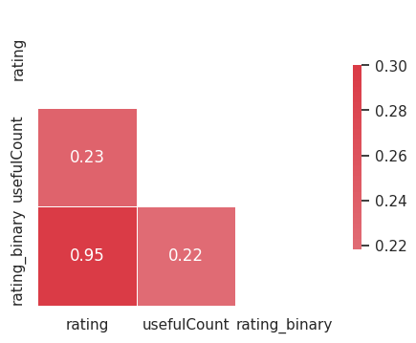
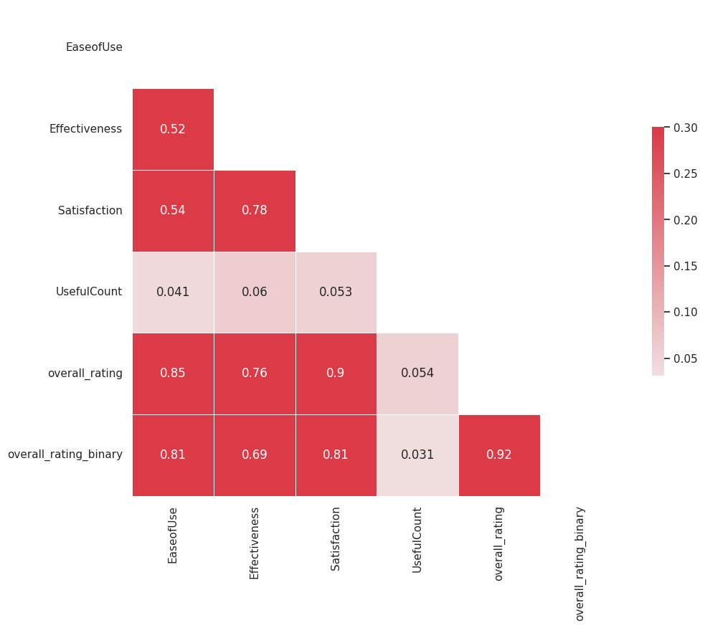
Correlation heatmap
Drug.com
Webmd
Notes:
thu

Slide 10
Review Word Cloud
Drug.com
Webmd
Notes:
thu

Slide 11
In-Domain Sentiment Analysis
Traditional NLP Methods

Slide 12
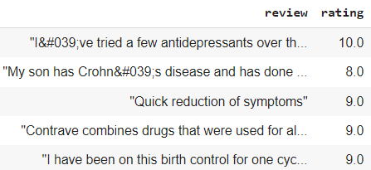
Drug Effectiveness and Satisfaction
Using Logistic Regression
WebMD
5. Create Logistic Regression pipeline using:
Class_weight = ‘balanced’
Parameters = clf__C: [0.01, 1]
6. Perform grid-search with 5 fold cross-validation and calculate best Accuracy and Cohen Kappa’s score
3. Extract n-grams features and set max threshold
4. Set X and y variables for predictions and split data:
X = Tri-gram features
Y = Rating
Drugs.com
Create classification labels for drug ratings (1:10):
Rating <= 4 is Negative (0)
4 < Rating < 7 is Neutral (1)
Rating >= 7 is Positive (2)
Pre-process the review data:
Text to lowercase
Remove punctuation and #s
Tokenize on spaces
9. Create Logistic Regression pipeline using:
Class_weight = ‘balanced’
Parameters = clf__C: [0.01, 1]
10. Perform grid-search with 5 fold cross-validation and calculate best Accuracy and Cohen Kappa’s score
7. Extract n-grams features and set max threshold
8. Set X and y variables for predictions:
X = Tri-gram features
Y = Rating
Notes:
shawn

Slide 13
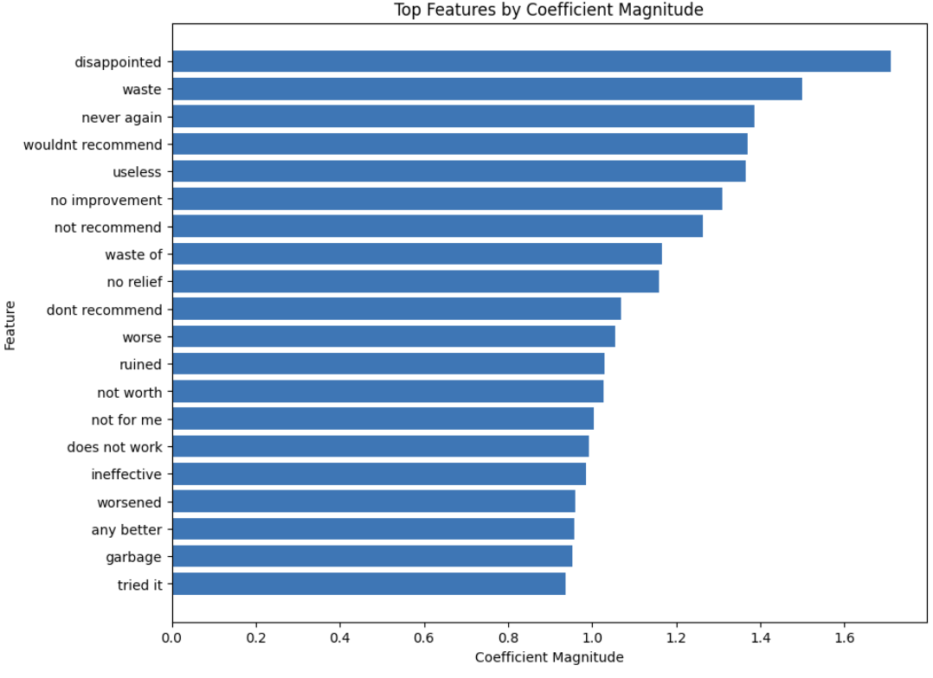
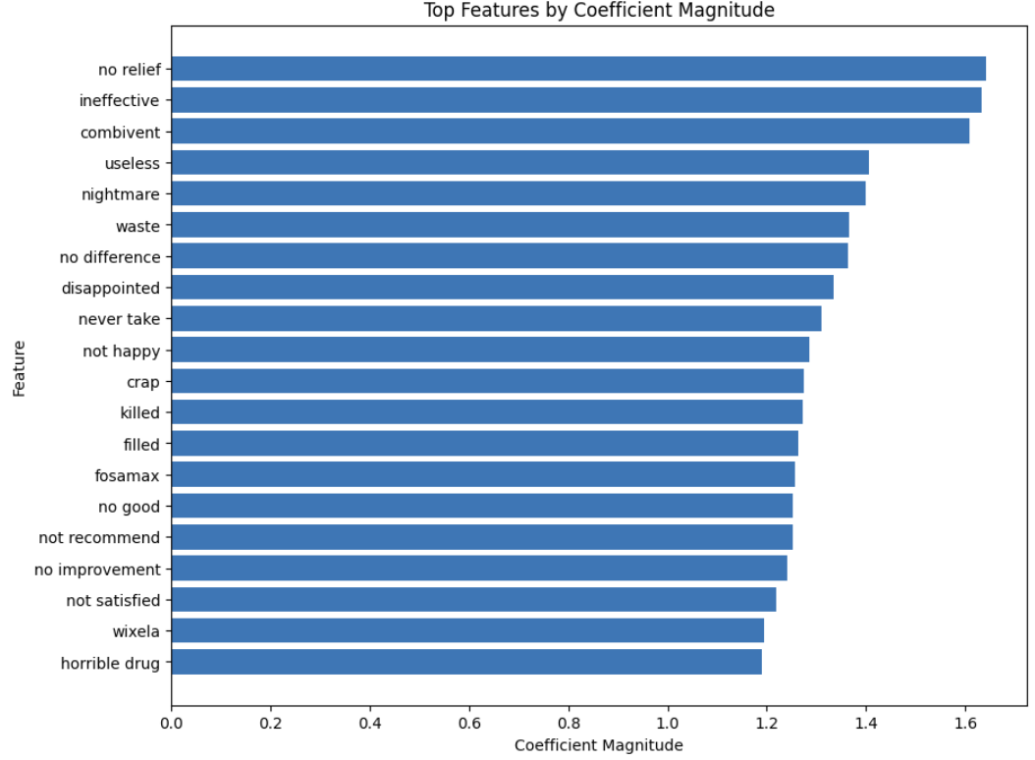
Drug Effectiveness and Satisfaction Using Logistic Regression
Drugs.com
WebMD
Notes:
shawn

Slide 14
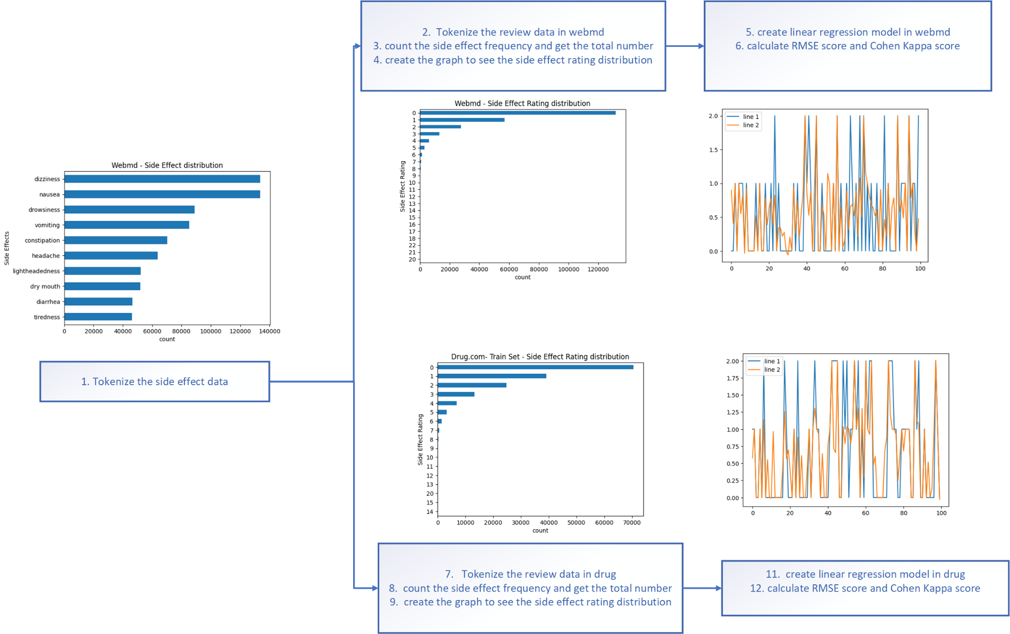
Side Effect Analysis using Linear Regression
Notes:
thu

Slide 15
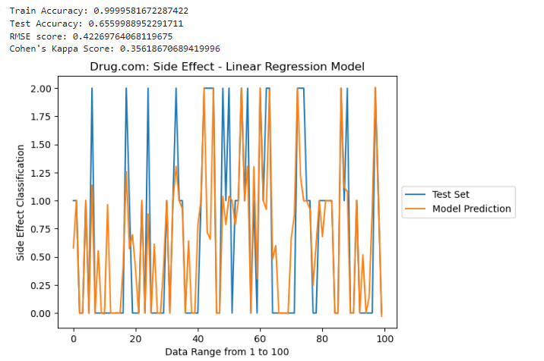
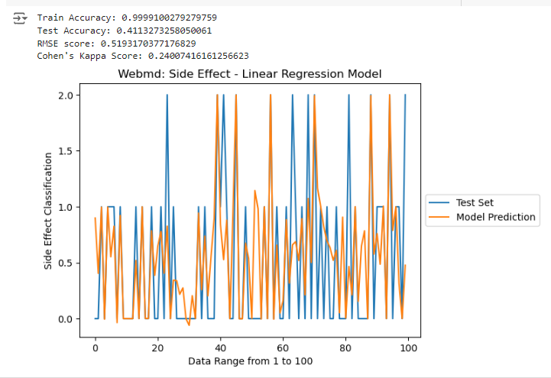
Side Effect Analysis using Linear Regression
Drugs.com
WebMD
Notes:
thu

Slide 16
In-Domain Sentiment Analysis
Deep Learning Methods

Slide 17
Drug Effectiveness and Satisfaction Using
RNN Gated Recurrent Unit
(GRU)
WebMD
5. Define model with 138 units, dropout layers of 0.5, and Dense output with softmax activation
6. Compile model with loss = sparse categorical crossentropy, optimizer = ‘adam’, and metrics = Accuracy
7. Evaluate model with test Loss and test Accuracy
3. Set X and y variables for predictions and split data:
X = Pad sequenced features
Y = Rating
4. Get Unique labels and Indices
Calculate Class Weights
Create classification labels for drug ratings (1-10):
Rating <= 4 is Negative (0)
4 < Rating < 7 is Neutral (1)
Rating >= 7 is Positive (2)
Pre-process the reviews:
Tokenize cleaned reviews
Create Vocab index
Convert Text to sequences
Pad sequences
10. Define model with 138 units, dropout layers of 0.5, and Dense output with softmax activation
11. Compile model with loss = sparse categorical crossentropy, optimizer = ‘adam’, and metrics = Accuracy
12. Evaluate model with test Loss and test Accuracy
Drugs.com
8. Set X and y variables for predictions and split data:
X = Pad sequenced features
Y = Rating
9. Get Unique labels and Indices
Calculate Class Weights
Notes:
shawn

Slide 18
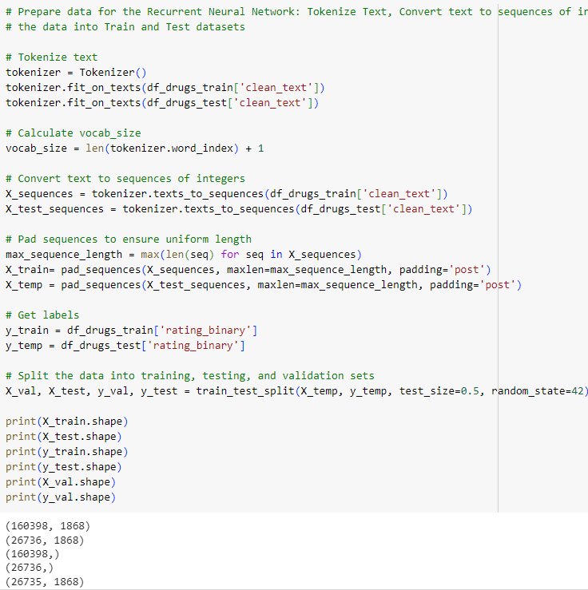
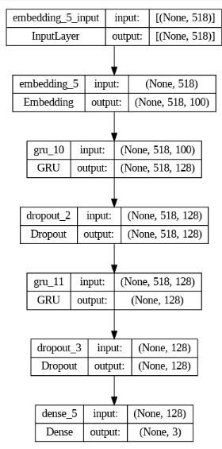
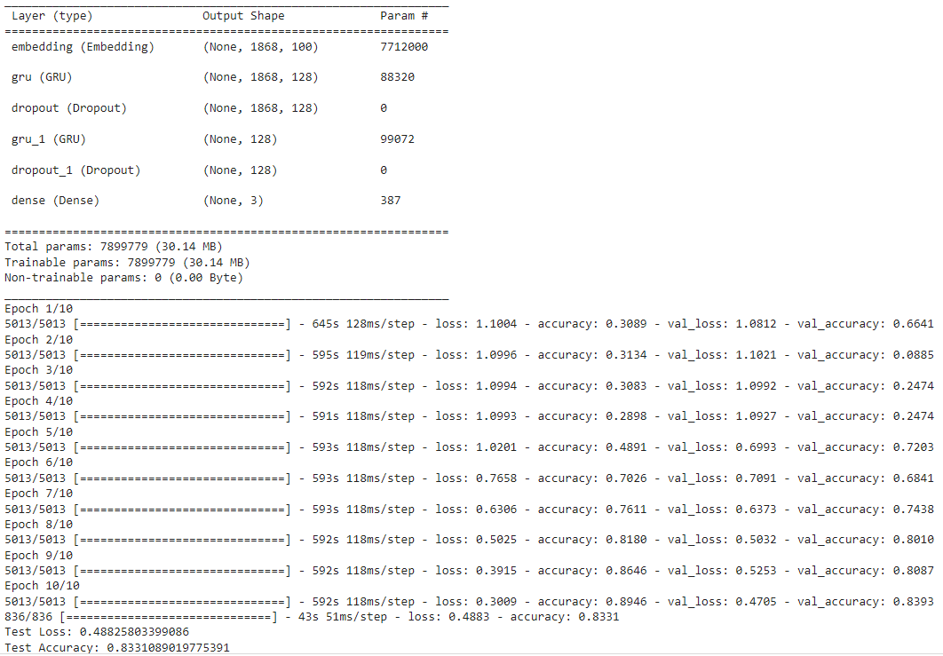
Drug Effectiveness and Satisfaction
Using GRU
Notes:
shawn

Slide 19
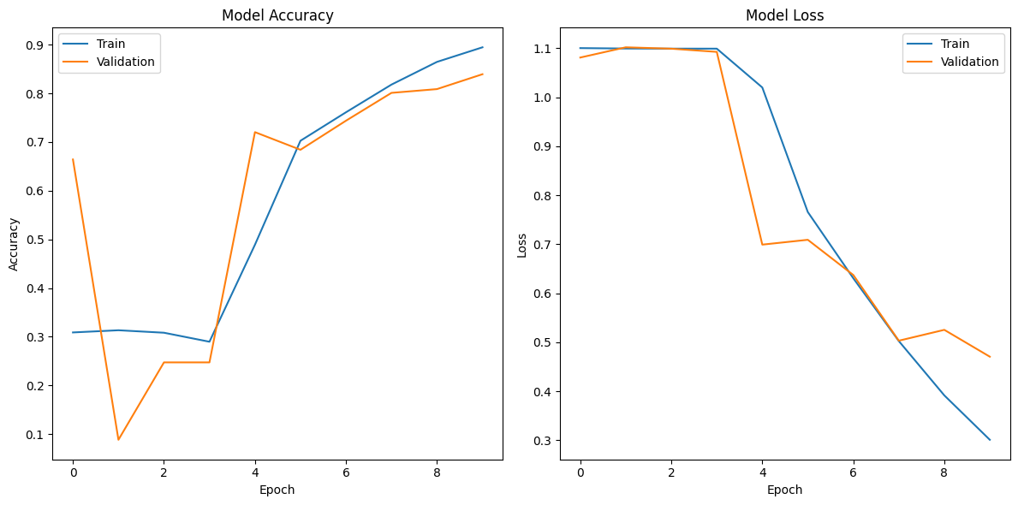
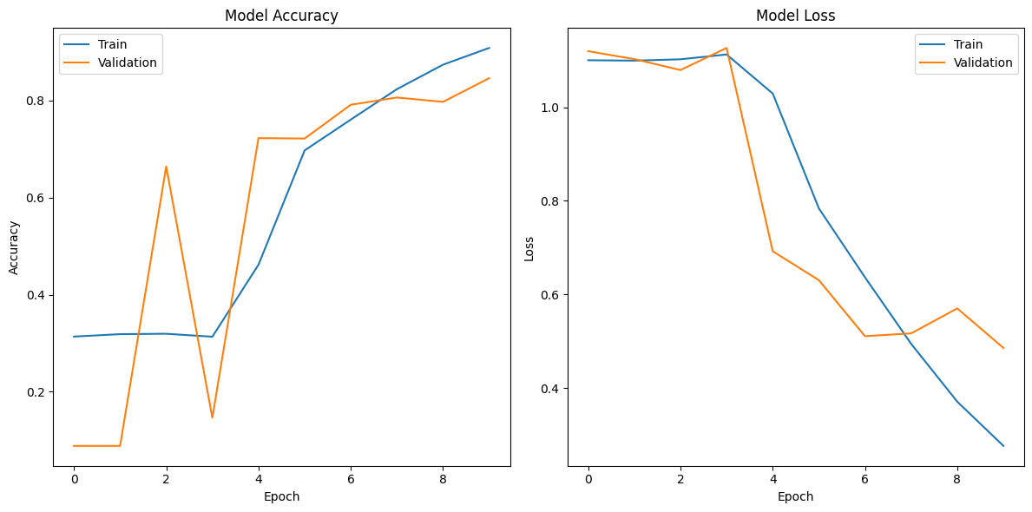
Drug Effectiveness and Satisfaction Using GRU
Drugs.com
WebMD
Notes:
shawn

Slide 20
Drug Effectiveness and Satisfaction Using
RNN Long Short Term Memory
(LSTM)
WebMD
3. Set X and y variables for predictions and split data:
X = Pad sequenced features
Y = Rating
5. Define model with 100 units, Bidirectional, and Dense output using softmax and relu activation
6. Compile model with loss = sparse categorical crossentropy, optimizer = ‘adam’, and metrics = Accuracy
7. Evaluate model with test Loss and test Accuracy
Create classification labels for drug ratings (1-10):
Rating <= 4 is Negative (0)
4 < Rating < 7 is Neutral (1)
Rating >= 7 is Positive (2)
Pre-process the reviews:
Tokenize cleaned reviews
Create Vocab index
Convert Text to sequences
Pad sequences
Drugs.com
8. Set X and y variables for predictions and split data:
X = Pad sequenced features
Y = Rating
9. Define model with 100 units, Bidirectional, and Dense output using softmax and relu activation
10. Compile model with loss = sparse categorical crossentropy, optimizer = ‘adam’, and metrics = Accuracy
11. Evaluate model with test Loss and test Accuracy
Notes:
jimmy

Slide 21
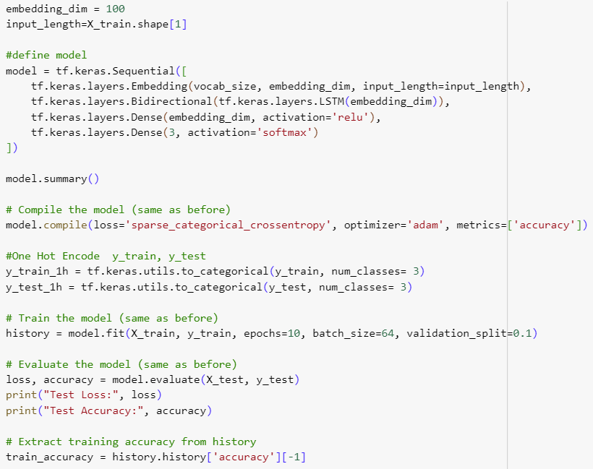
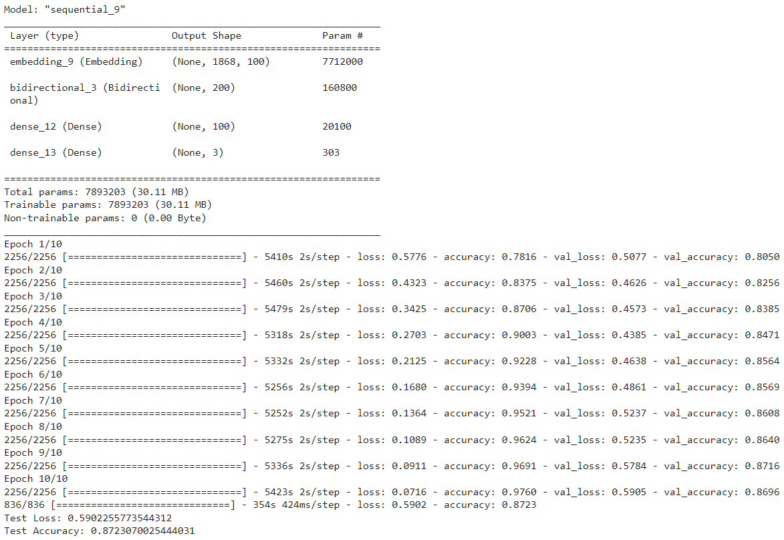
Drug Effectiveness and Satisfaction Using LSTM
Notes:
jimmy

Slide 22
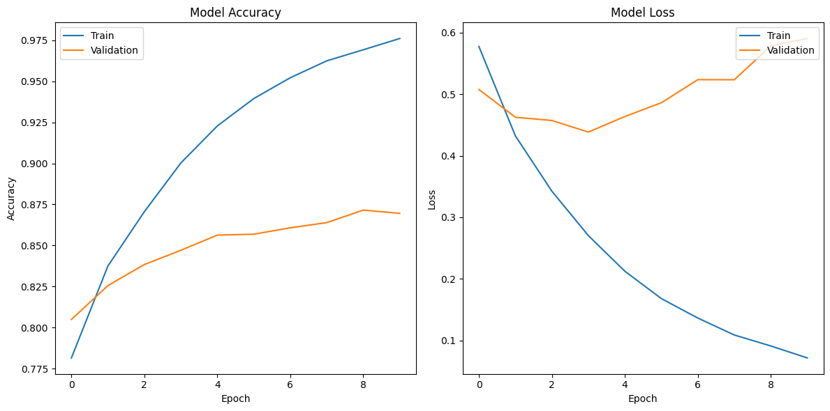
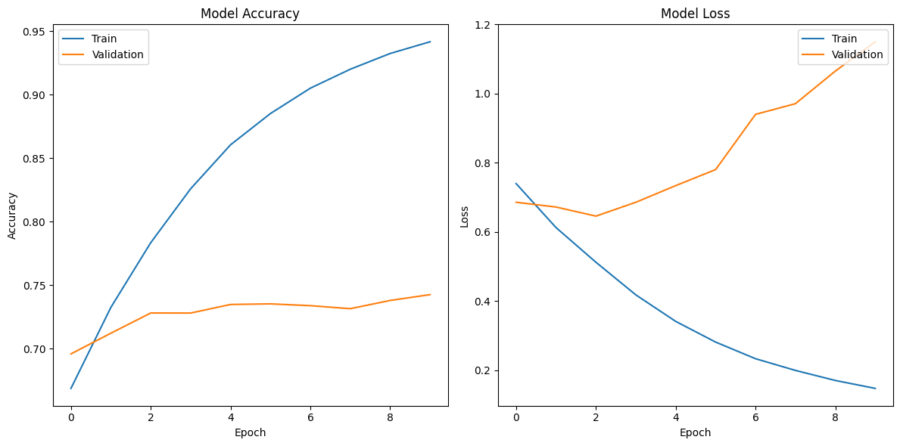
Drug Effectiveness and Satisfaction Using LSTM
Drugs.com
WebMD
Notes:
jimmy

Slide 23
Cross-Data Sentiment Analysis

Slide 24
Cross-Data Model
Using Linear Regression
Drugs.com Train Set and WebMD Test Set
3. Create a preprocessor with one hot encoder to handle numeric and categorical vars
4. Set X and y variables for predictions and split data:
X = All features minus Rating
Y = Rating
5. Create Linear Regression pipeline using:
Imputer, standard scaler
6. Evaluate model with Accuracy, RMSE, and Cohen Kappa’s score
Create classification labels for drug ratings (1:10):
Rating <= 4 is Negative (0)
4 < Rating < 7 is Neutral (1)
Rating >= 7 is Positive (2)
Pre-process the review data:
Text to lowercase
Remove punctuation and #s
Tokenize on spaces
WebMD Train Set and Drugs.com Test Set
3. Create a preprocessor with one hot encoder to handle numeric and categorical vars
4. Set X and y variables for predictions and split data:
X = All features minus Rating
Y = Rating
5. Create Linear Regression pipeline using:
Imputer, standard scaler
6. Evaluate model with Accuracy, RMSE, and Cohen Kappa’s score
Notes:
Thu

Slide 25
In-Domain Sentiment Analysis
Results

Slide 26
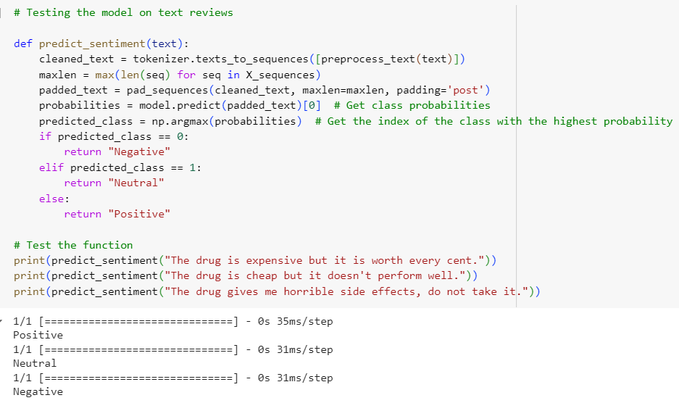
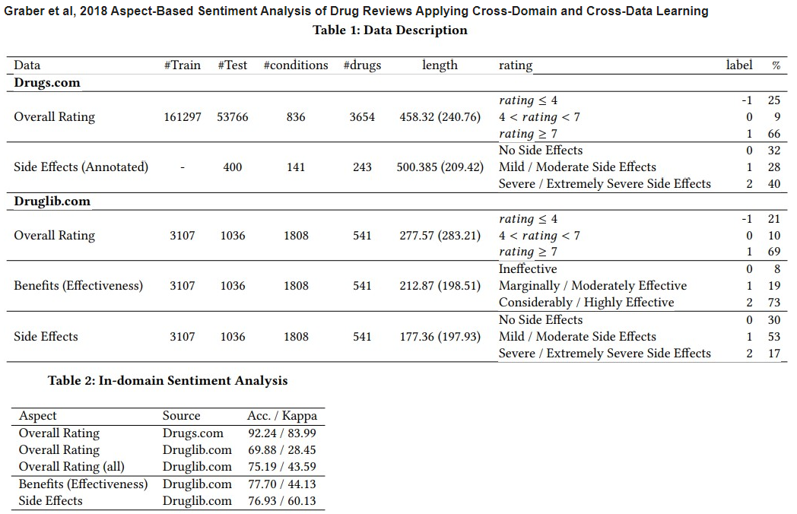
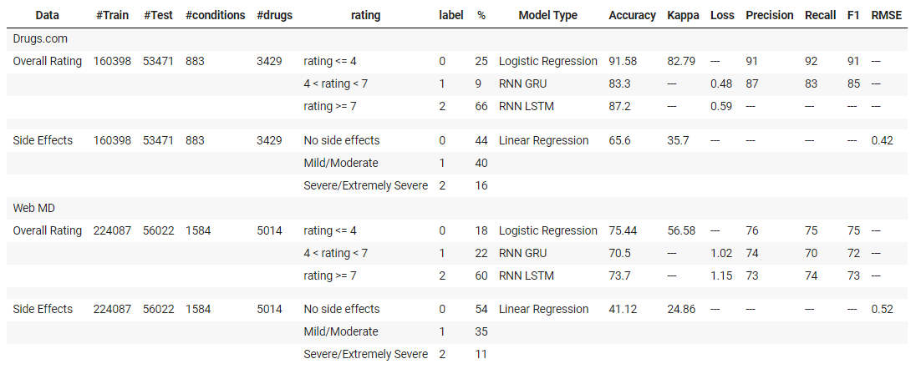
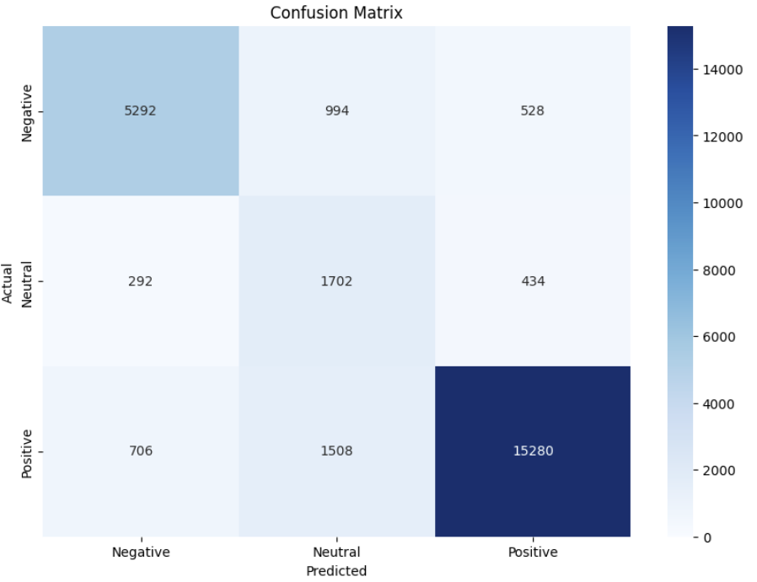
Results for In-Domain Sentiment Analysis
Notes:
shawn

Slide 27
Cross-Data Sentiment Analysis
Results

Slide 28
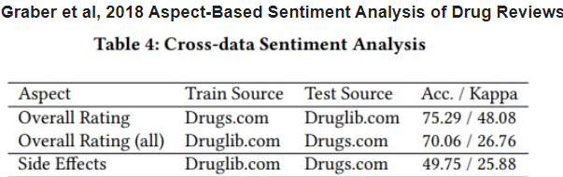
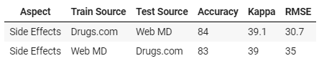
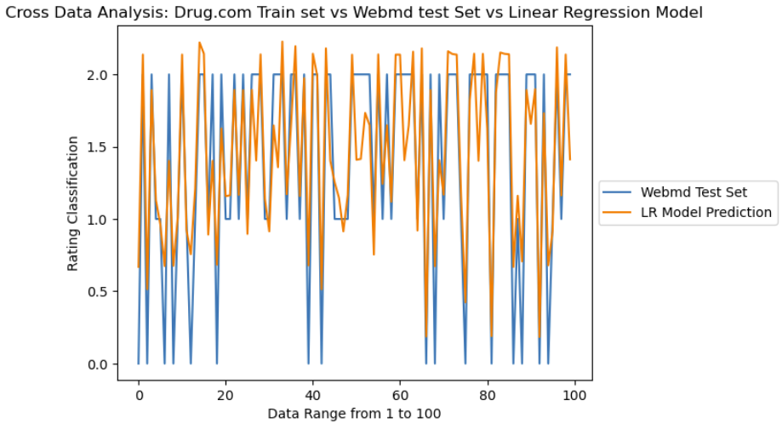
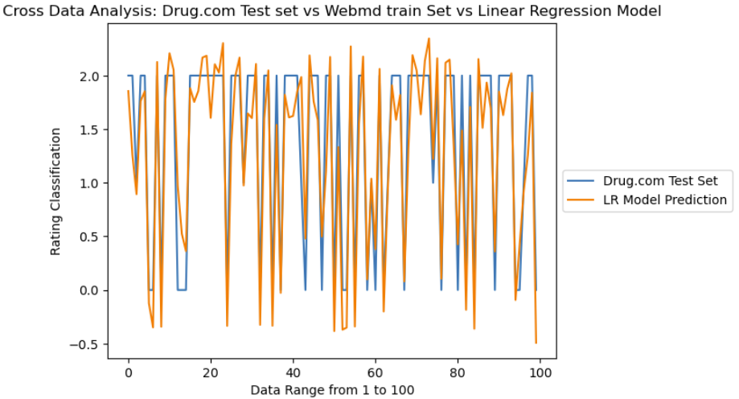
Results for Cross-Data Sentiment Analysis
Drugs.com Train Set and WebMD Test Set
WebMD Train Set and Drugs.com Test Set
Notes:
shawn

Slide 29
Challenges/Limitations/Future Work
Logistic Regression and Linear Regression models were severely overfitted
Ran out of time to properly reduce overfitting
GPUs had to be used by purchasing google collab pro to process over 15 million parameters as the CPUs crashed every time
Traditional NLP and Deep Learning Model refinement, feature engineering and more in-depth processing of textual reviews needed to achieve better overall results
Continue research by performing Cross-Domain Sentiment Analysis by evaluating the transferability of models among medical domains, (i.e. conditions such as Depression vs Anxiety)
Notes:
shawn

